Slide 1
VATLD: A Visual Analytics System to Assess, Understand and Improve Traffic Light Detection Liang Gou, Lincan Zou, Nanxiang Li, Michael Hofmann, Arvind Kumar Shekar, Axel Wendt and Liu Ren Sepehr (Sep) Sabeti – ITCS 4123/5123 – Visualization and Visual Communications

Slide 2
Overview
Problem
Methodology
Data
Results
Conclusion

Slide 3
Problem
Traffic light detection is critical in autonomous driving.
State-of-the-art AI algorithms are generally trained and lack context in the training process
There is not enough data showing the vulnerability of models in detecting traffic lights
It all boils down to this:
Model accuracy over the available data
Model robustness on unseen data

Slide 4
Contribution
a novel visual analytics method to asses, understand and improve a detector’s performance of both accuracy and robustness
adapting a representation learning method to efficiently summarize, navigate and diagnose the performance of detectors over large amounts of data
proposing a new semantic adversarial learning algorithm to efficiently reveal the robustness issues of detectors without knowing detector parameters
demonstrating the effectiveness of model improvement strategies guided by visual analytics for real world problems, and illustrating a promising way of injecting human intelligence into models with few human interaction.
alleviating some trustworthy AI issues in autonomous driving applications by applying visual analytics and human-in-the-loop approaches

Slide 5
Design Requirements
human-friendly data representation and summarization
efficient generation of unseen test cases
a contextualized understanding for model performance
performance interpretation for both accuracy and robustness
injecting human intelligence for performance improvement with minimal human interaction

Slide 6
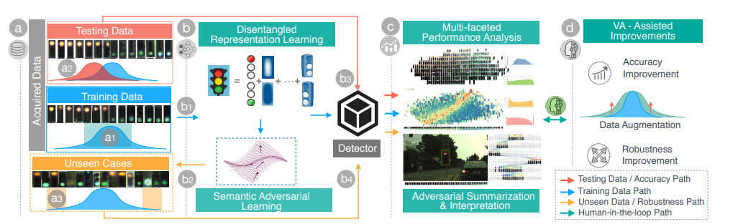
Methodology

Slide 7
Methodology
Data Processing
Data Representation
Iterative Visualization
Visual-analytics Assisted Improvements

Slide 8
Data Representation
disentangled representation learning: this component first provides a human-friendly data presentation, and also offers a data space where an adversarial generation can efficiently search.
semantic adversarial learning: it learns prediction behaviors of a detector, and generates meaningful adversarial examples

Slide 9
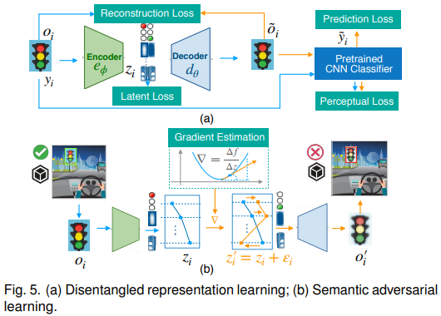
Data Representation

Slide 10
Iterative Visualization
The third module transforms detection results, as well as the metadata (object size, disentangled representation, gradients etc), into interactive and human-friendly visualizations including multifaceted performance analysis and adversarial summarization and interpretation.

Slide 11
Visual-analytics Assisted Improvements
Finally, with minimal human interaction from visual interface, actionable insights are derived to generate more data that attempt to increase the accuracy and robustness in traffic light detection.

Slide 12
Acquired Data
Three types of data, including top-n detections, ground truth objects, and semantic adversarial objects, for analysis were extracted.
For each type of data, performance information (bounding boxes, confidence sores, IoUs), data representation (image patches, latent vectors) and other meta-information (size, class, gradient, robustness) were collected

Slide 13
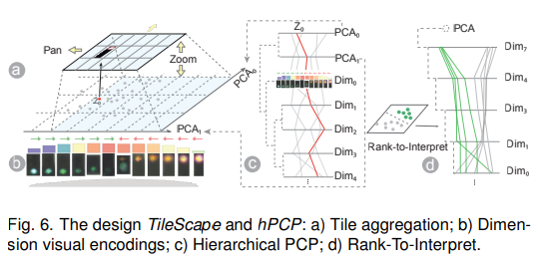
Designed User Interface

Slide 14
Designed User Interface
hPCP → TileScape. Any dimension from hPCP can be selected as x or y axis for TileScape to examine what visual semantics are embedded in this dimension. Also by hovering or brushing the dimension bins in hPCP, corresponding tiles in TileScape are highlighted to show what visual feature the selected bins capture.
TileScape → hPCP. Interaction from TileScape to hPCP enables users to interpret detector’s performance with the semantics learned by latent dimensions. Users can use a lasso to select a group of bins of interest (e.g. low confidence scores) in TileScape, and corresponding lines and bins are highlighted in the latent space of hPCP.

Slide 15
Results
Authors cropped 10683 valid traffic lights from the training dataset and then resized them into 64x64 to train the models of disentangled representation (DRL) and adversarial learning (SeADV).

Slide 16
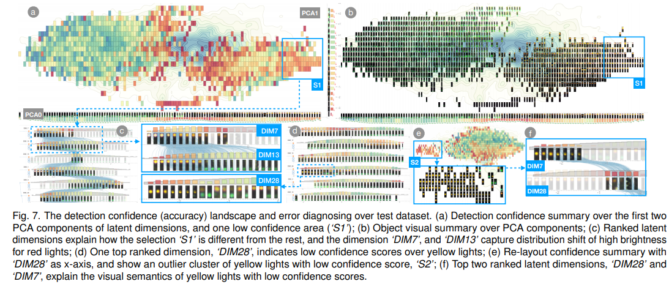
Results - the confidence landscape over test dataset

Slide 17
Results - the confidence landscape over test dataset
There was a clear distribution imbalance of detection accuracy over different object colors, as shown in Fig. 7- a b . The semantics of color were captured by the first PCA component for latent dimensions, and shown as the x-axis in Fig. 7- b : right for red and left for green light (the color variance was learned from the data, and we didn’t explicitly use color attributes).
Secondly, data distribution gap and low confidence score areas were observed. There was a large sparse area in the middle of Fig. 7- b , indicating testing data has less coverage in this area (compared with the background density map built from the training dataset).

Slide 18
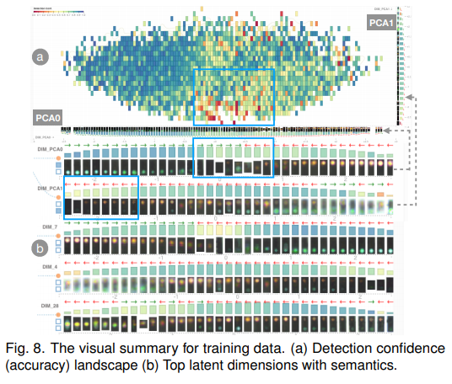
Results - What confused the detector

Slide 19
Results - What confused the detector
The middle range of PCA0 explains the ambiguity of traffic lights caused low confidence scores (as PCA0 mainly captures the variations of colors)
The lower end of PCA1 shows dark traffic lights are difficult for the detector (as PCA1 mainly explains the variations from dark to bright).

Slide 20
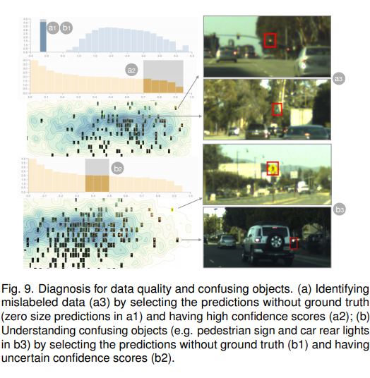
Results - Identifying noisy labels, confusing objects and more

Slide 21
Results - Identifying noisy labels, confusing objects and more
The multi-faceted visual analysis enabled the experts to conduct more useful diagnosis about data quality and detector behaviors. For example, it helped the experts identify data with missing labels, as shown in Fig. 9- a3 by selecting FPs with high confidence scores (Fig. 9- a1 a2 ).

Slide 22
Conclusion
The proposed approach is built upon a representation learning to augment human cognition with human-friendly visual summarization, and a semantic adversarial learning to expose interpretable robustness issues with minimal human interactions.
It was also demonstrated that the effectiveness of performance improvement strategies derived with VATLD, and illustrated practical implications for real-world problems in production environments.
It could capture a silver of ways of applying the approaches of visual analytics and human-in-the-loop to alleviate some trustworthy AI issues in autonomous driving domain.

Slide 23
Future Works
Extended to multi-object detection
Representation learning with powerful expressiveness
Understanding detector beyond objects

